Slide 1

Real-Time Reassignment of Audit Instruction
Team: Data Dudes
Logeshwaran, Bharath Kumar, Aakash
OMNI US

Slide 2
Overview
CHALLENGE OVERVIEW
PAIN POINTS
OBJECTIVE
TECH STACK
POST METHOD
PUT METHOD
DEMO OF THE APPLICATION
FUTURE UPDATES

Slide 3


Challenge Overview
Auditors assigned to locations via fixed plans
Disruptions (store closures, auditor unavailability, ownership changes) are common
Current process is manual, reactive, and time-consuming

Slide 4
Pain Points
Audit delays & missed deadlines
Manual coordination across planners & auditors
Poor visibility into auditor workload & availability
Loss of audit continuity when reassignments occur

Slide 5
Objective: Enable dynamic reassignment of audit plan during disruptions
Proposed Solution:
Detect reassignment needs automatically.
Suggest optimal auditor-store pairing using:
Auditor availability and workload.
Geolocation proximity (latitude & longitude).
Impact:
Minimize audit delays and manual intervention.
Maintain audit continuity and data integrity.
Improve planner and auditor experience.
Challenges in Current Process: Manual reassignment loads to delays, inefficiencies and data inconsistencies.

Slide 6
Tech Stack: Backed: Java, Spring Boot, PostgreSQL Frontend: Streamlit
Entities Developed:
Auditor: Name, Availability status, location details, workload capacity, currently assigned workload.
Store: Name, location details and status.
Audit Plan: Links auditor and store with schedule details with Priorities

Slide 7
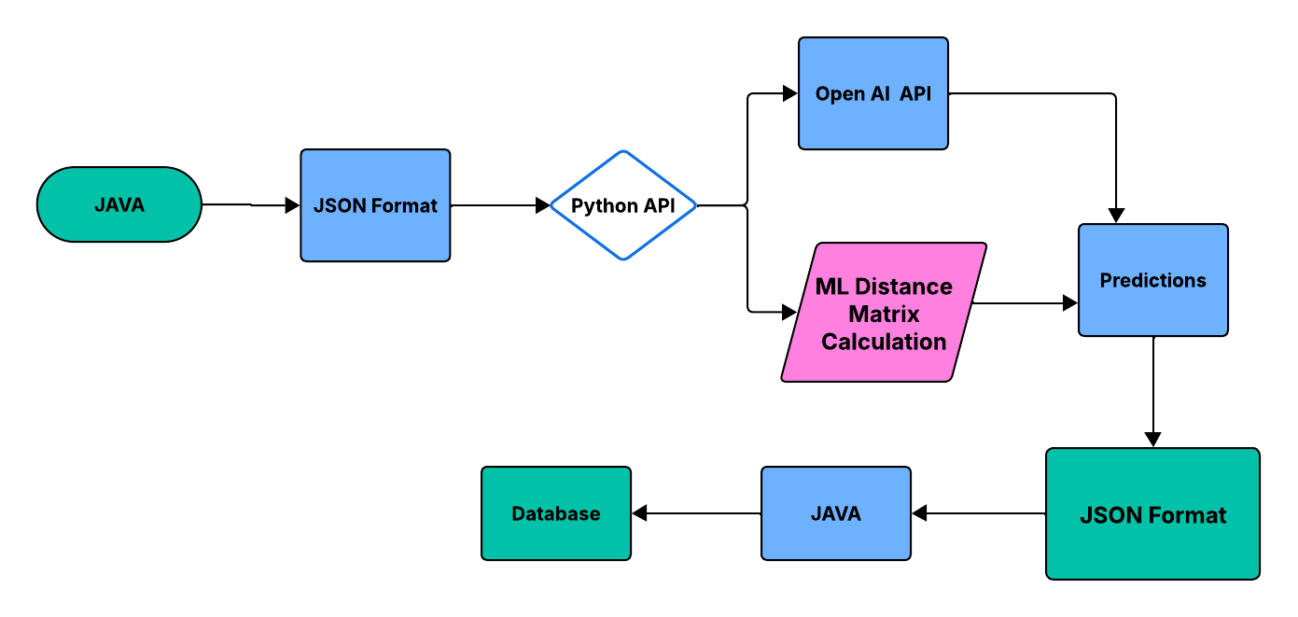
POST Method

Slide 8
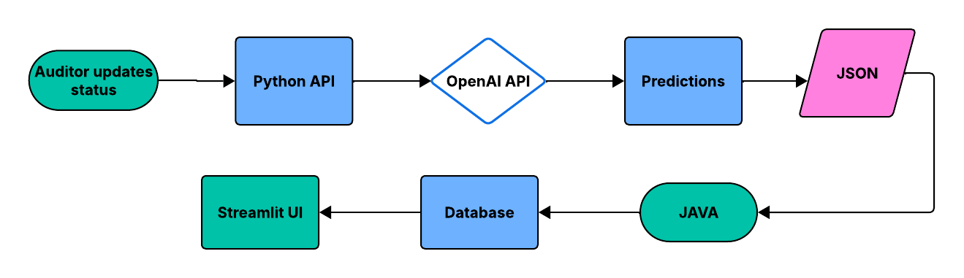
PUT Method

Slide 9
Application Demo

Slide 10
Future Updates
Distance Calculation
Distance-Based Optimization:
Implement Euclidean and Manhattan distance calculations for precise auditor-store proximity analysis.
ML
Machine Learning Models:
Develop predictive models for auditor assignment and reassignment based on workload capacity and historical data.

Slide 11
Thank You

